Slide 1

Welcome to Database Foundations for Business Analytics
BUAN 6320
August 23, 2018
Dr. James Scott
Introduction to Relational Databases
The University of Texas at Dallas
utdallas.edu

Slide 2
Questions
What is the difference between Data and Information?
Q1: What is the purpose of a database?
Q2: What is a database?
Q3: What Are the Components of a Database Application System? What is a database management system?
Notes:
This chapter discusses why, what, and how of database processing.
Describes purpose of databases and explains important components of database systems.
Overviews process of creating a database system and summarize your role as a future user.

Slide 3
Data vs. Information
Data
Information
Raw facts
Raw data - Not yet been processed to reveal the meaning
Building blocks of information
Data management
Generation, storage, and retrieval of data
Produced by processing data
Reveals the meaning of data
Enables knowledge creation
Should be accurate, relevant, and timely to enable good decision making

Slide 4
Q1: What Is the Purpose of a Database?
“Keep track of things”
Allows for abstract representation of economic entities and events
Selling products
Customer? (ID, billing address)
Product? (ID, price)
Transaction? (when, how much)
Building products
Supplier addresses
BOM
Raw material prices
Creating customers
Who visited our website?
What are our customer profiles (obtained via survey, 3rd party data collection)
Competitive analysis
Which then allows us to conduct track, conduct, manage, decide, etc.
Notes:
General rule:
Use a spreadsheet for lists of data involving single theme.
Use a database for data with multiple themes.

Slide 5
Q1: What Is the Purpose of a Database?
Organize and keep track of things
Keep track of multiple themes
General rule:
Single theme - store in a spreadsheet
Multiple themes - use a database
What's a theme?
Ex: Student Grades
Notes:
General rule:
Use a spreadsheet for lists of data involving single theme.
Use a database for data with multiple themes.

Slide 6
Database versus Spreadsheet
A spreadsheet is not a database.
Databases over several advantages over spreadsheets. What are they?
Notes:
Security
Efficiency
Reporting
Capacity
Maintenance
Less duplication

Slide 7
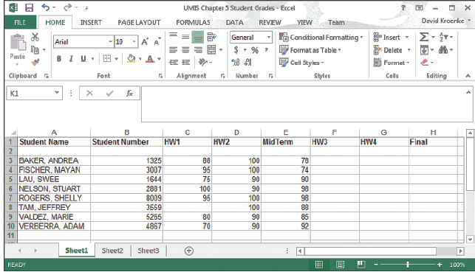
A List of Student Grades Presented in a Spreadsheet – Single Theme
Notes:
Key distinction between this figure and next slide is data, Student Grades, is about a single theme

Slide 8
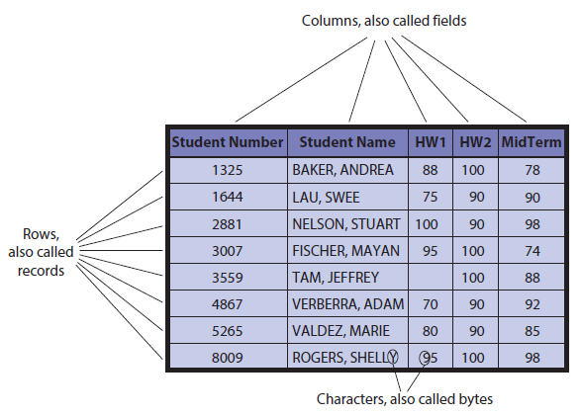
Q2: What Is a Database?
Notes:
Relationships of rows and columns in a database.
Database - self-describing collection of integrated records.

Slide 9
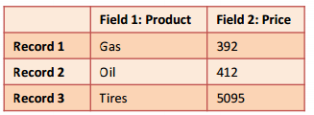
What is a database?
A collection of data that represents something of “meaning” to users (i.e., information)
Data is grouped together in fields by what they mean, e.g.,
Gas, oil, and tires are all products that are sold and are stored in field 1
392, 412, and 5095 are all prices of products and are stored in field 2
Related fields are “tied” together in records, e.g., record = product + price

Slide 10
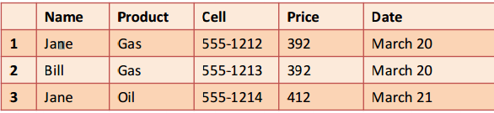
What is a database?
Records are stored in rows.
Records represent all the information about a single entity.
Fields are stored in columns.
Columns are “properties” or “attributes” we want to store about our entity of interest (e.g. sales).
Field/Column
Record/Row

Slide 11
Q2: What Is a Database?
Records that store the same type of information are stored together in tables (e.g., products, customers, and sales).
Tables represent the complete information we want to store about the economic event or entity.
Notes:
A database is a self-describing collection of integrated records. This figure shows a two-dimensional table, or file. The rows represent records and the columns represent fields. Also, shown is the hierarchy of data: bytes/characters, fields or columns, and records/rows.

Slide 12
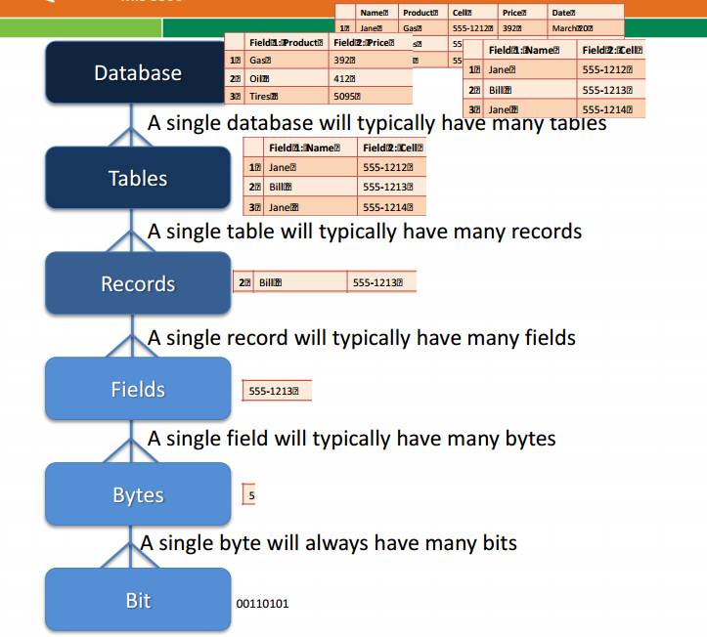
Hierarchy of Data Elements
Notes:
Database is a collection of related tables.

Slide 13
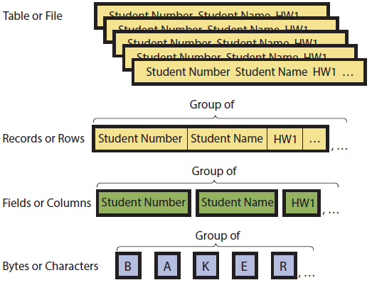
Hierarchy of Data Elements
Notes:
Database is a collection of related tables.

Slide 14
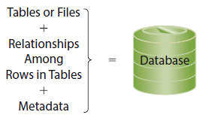
Components of a Database
Notes:
Formal term for table is “relation”. Linking relations together creates relationships. A database is a group of related tables. Metadata describes definitions o tables, fields and relationships.

Slide 15
Types of Databases
Hierarchical DB
Network DB
Relational DB
Object-Oriented DB
See Word Document “DBMS Comparisons”

Slide 16
Relational Databases
Emphasizes relationships between tables (entities).
These relationships link tables together easily.
Examples?

Slide 17
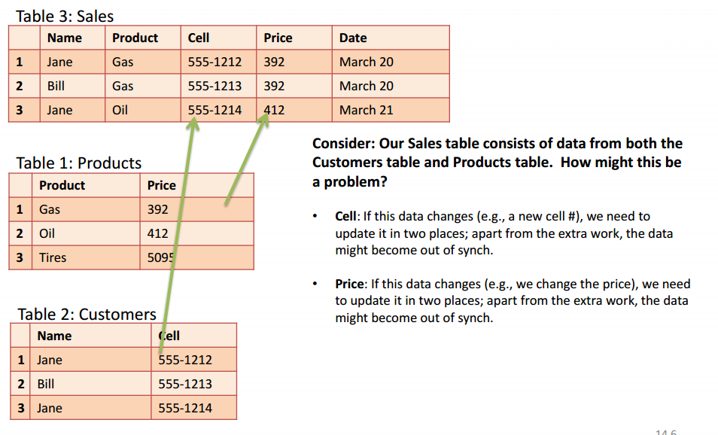
Relational Databases
Notes:
Cell: If this data changes we need to update it in two places. Apart from the extra work the data might become out of sync. The same holds true for price.

Slide 18
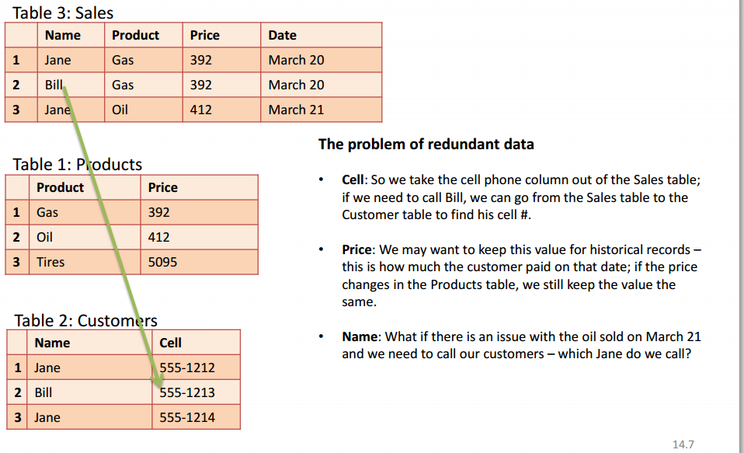
Relational Databases

Slide 19
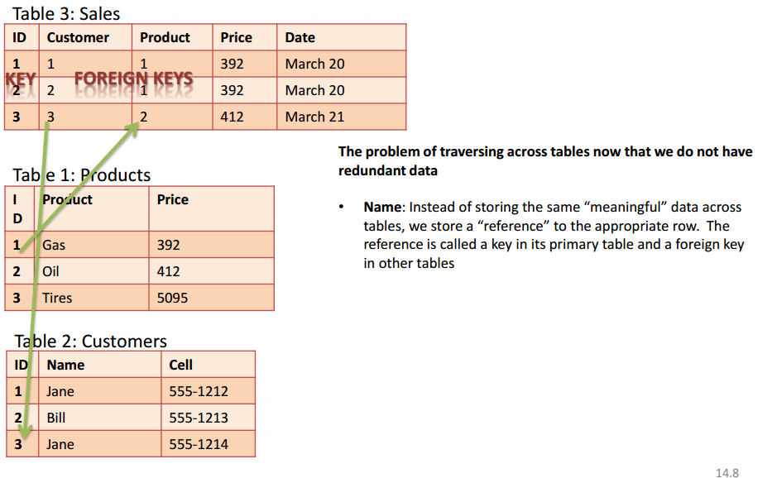
Relational Databases

Slide 20
Database Keys
Establish the relationships between tables.
Primary Key
A column or group of columns that identifies a unique row in a table.
Foreign Key
A column in a table that is a primary key in a corresponding table.

Slide 21
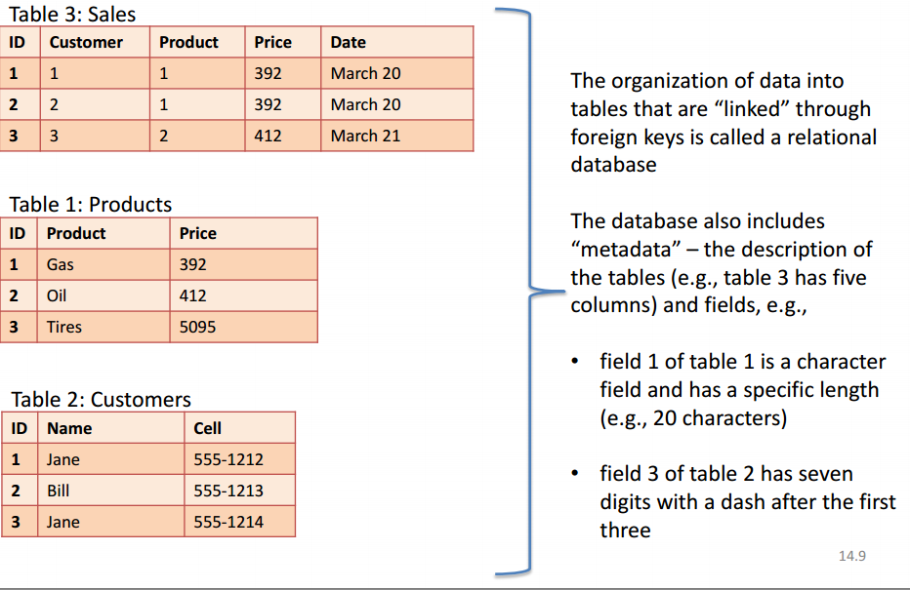
Relational Databases

Slide 22
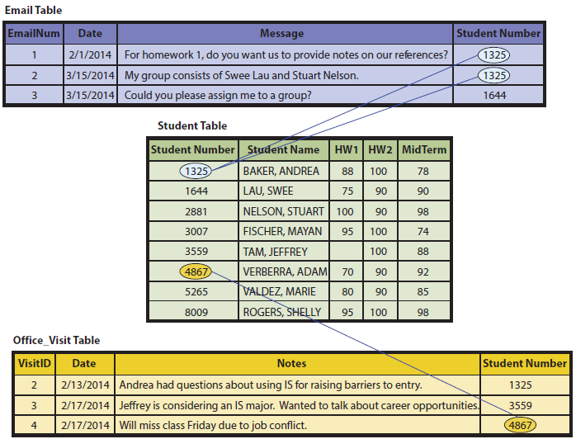
Example of Relationships Among Rows
Notes:
Foreign keys of top and bottom tables related to primary keys of Student Table.

Slide 23
So What? Not What the Data Says . . .
Perception based on small sample
“I called four different sales reps, and they said they can’t get any prospects to bite.”
Fact: “Not what the data says."
Key skill - isolating facts from our perceptions.
Look objectively at facts and not just perceptions of facts
ANALYTICS!
Notes:
Perceptions are tainted by our desires and biases.
The Firm’s database contains data on everything customers do. It’s their most important asset.
The Firm’s customers make about 15,000 visits a year, an average of 500 visits per day. It keeps data on every customer and every visit.

Slide 24
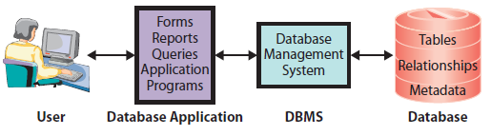
Q3: What Are the Components of a Database Application System?
Database Application System Components
Notes:
The components of a database application system include a user, database applications, the DBMS and the actual database. Applications make databases more accessible and useful for people. Users employ database applications that consist of forms, formatted reports, queries, and application programs.
DBMS is software used to create applications, process data, provide access to the database, and manage the database. Popular DBMSs include: DB2, Microsoft Access, SQL Server, Oracle, MySQL (open-source DBMS).

Slide 25
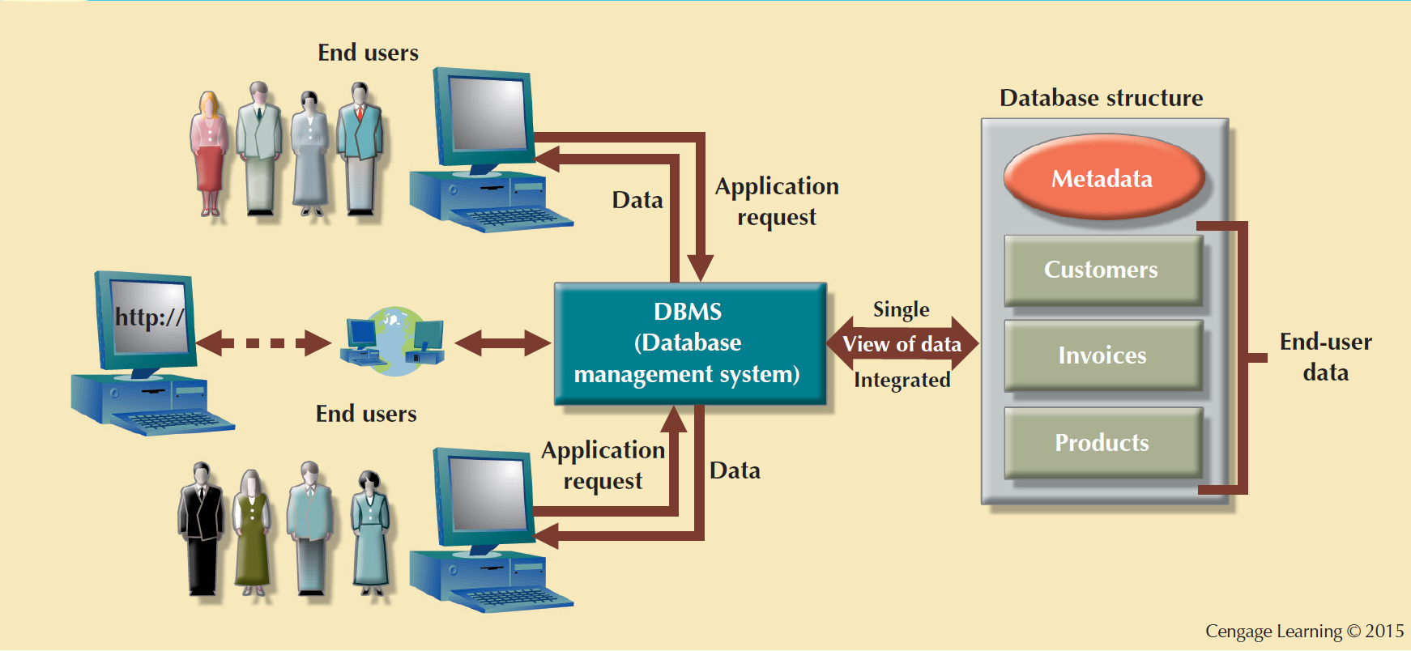
The DBMS Manages the Interaction between the End User and the Database

Slide 26
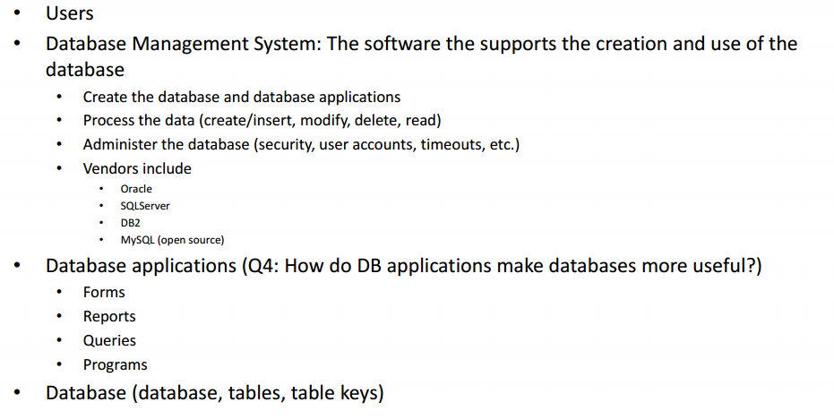
Components of a Database System

Slide 27
What Is a Database Management System (DBMS)?
Program used to create, process, and administer a database
Licensed from vendors such as IBM, Microsoft, Oracle, and others
DB2, Access and SQL Server, Oracle Database
MySQL - open source, license-free for most applications

Slide 28
Processing the Database
Four DBMS operations
Read
Insert
Modify
Delete data
Notes:
These operations are requested in applications that call upon DBMS in different ways.

Slide 29
Processing the Database
Structured Query Language - SQL (see-quell)
International standard
Used by most popular DBMS
Notes:
Structured Query Language (SQL) used for processing the database. SQL - international standard language for creating databases and database structures, and processing databases. Used by all popular DBMS products.

Slide 30
Processing the Database
SELECT [fields] FROM [tables] WHERE [condition]
INSERT INTO Student
([Student Number], [Student Name], HW1, HW2, MidTerm)
VALUES (1000, ‘Franklin, Benjamin’, 90, 95, 100);
Notes:
Structured Query Language (SQL) used for processing the database. SQL - international standard language for creating databases and database structures, and processing databases. Used by all popular DBMS products.

Slide 31
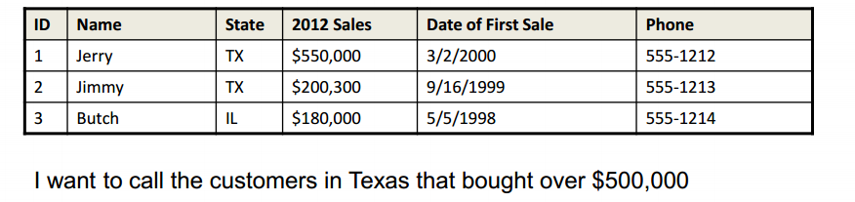

SQL

Slide 32
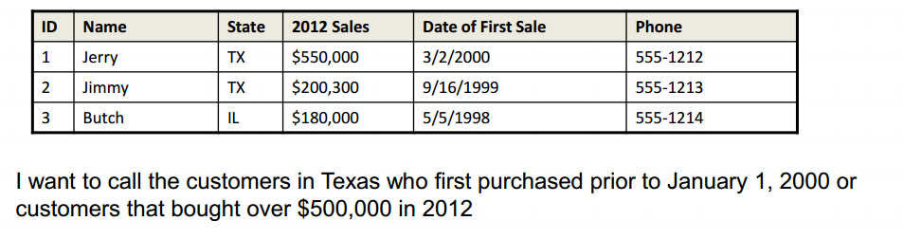
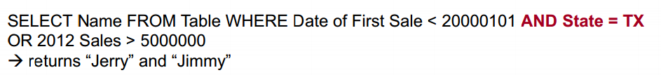
SQL

Slide 33
Administering the Database
Set up security system involving user accounts, passwords, permissions, and limits for processing
Limit user permissions in very specific ways
Backing up database data, adding structures to improve performance of database applications, removing unwanted data
Notes:
Third DBMS function is to provide tools to assist in the administration of the database.

Slide 34
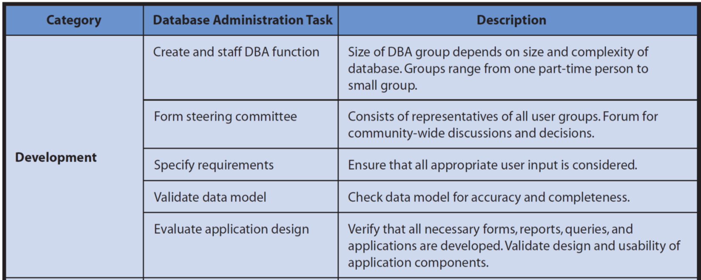
Summary of Database Administration Tasks

Slide 35
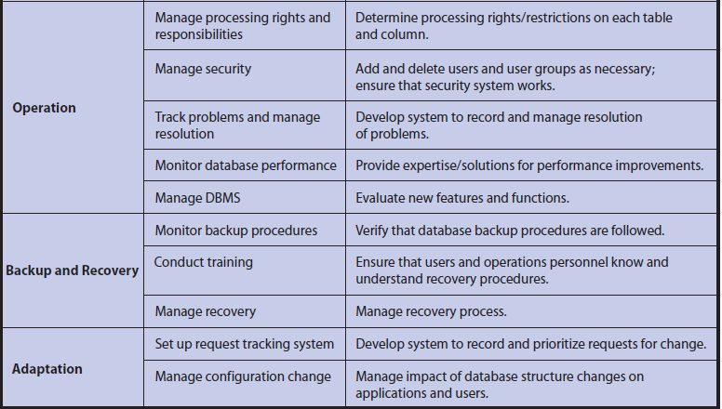
Summary of Database Administration Tasks (cont'd)
Notes:
DBMS provides tools to assist in database administration. Database administration involves a wide variety of activities.
Permissions can be limited in very specific ways.

Slide 36
How Much Is a Database Worth?
Data has resale value
Data on everything customers do
Use to target customer for offerings they care about, avoid those they don’t
Costly and difficult to replace data collected over many years
American Airlines CEO’s Response to Reporter when asked if the CEO could keep either all of the planes in American Airlines or Sabre (Database System for booking flights by the Airline Industry)? Which do you think he picked?
Notes:
For FlexTime, the database contains data on everything customers do. Their database is the single most important asset. “Take away our customer database, however, and we’d have to start all over. It would take us years to get back to where we are now.”
FlexTime customers make about 15,000 visits a year, an average of 500 visits per day. FlexTime keeps data on every customer and every visit.
That data could be sold to others who wish to pay for it. It also has competitive value because it can be used to improve FlexTime’s services and facilities, identify trend, etc. Replacing years of rich data would take a long time and be very expensive.

Slide 37
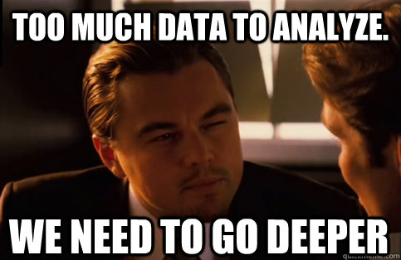
Wolf of Wall Street Scene

